Slide 1
Chapter 9 Working with Profile Data
By Kayla Xue
04/26/2020

Slide 2
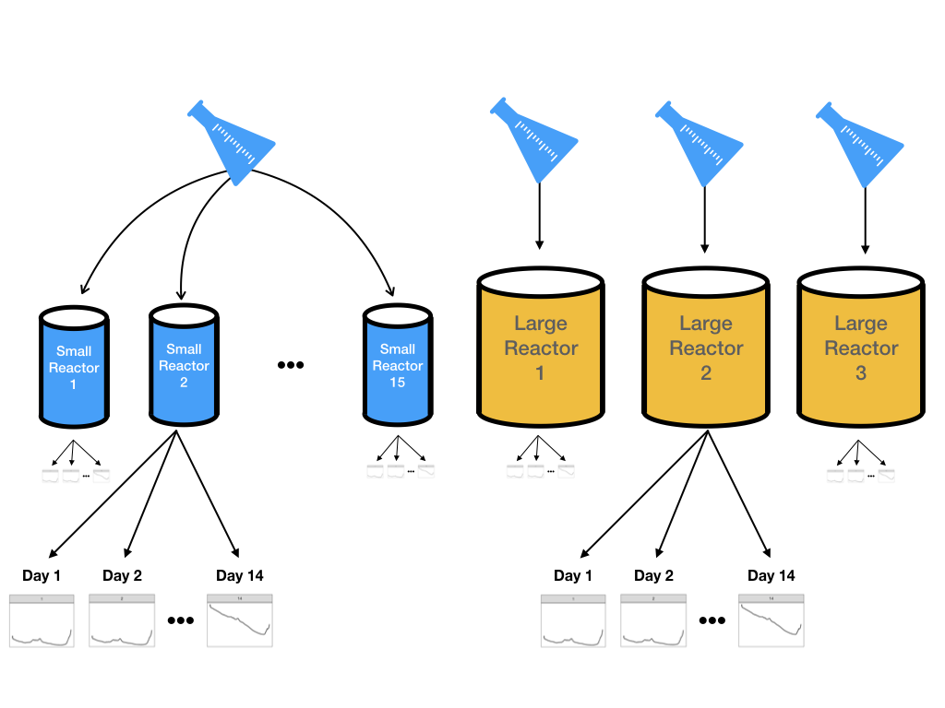
9.1 Illustrative Data: Pharmaceutical Manufacturing Monitoring
The goal would be to create models on the data from the more numerous small-scale bioreactors and then evaluate if these results can accurately predict what is happening in the large-scale bioreactors.

Slide 3
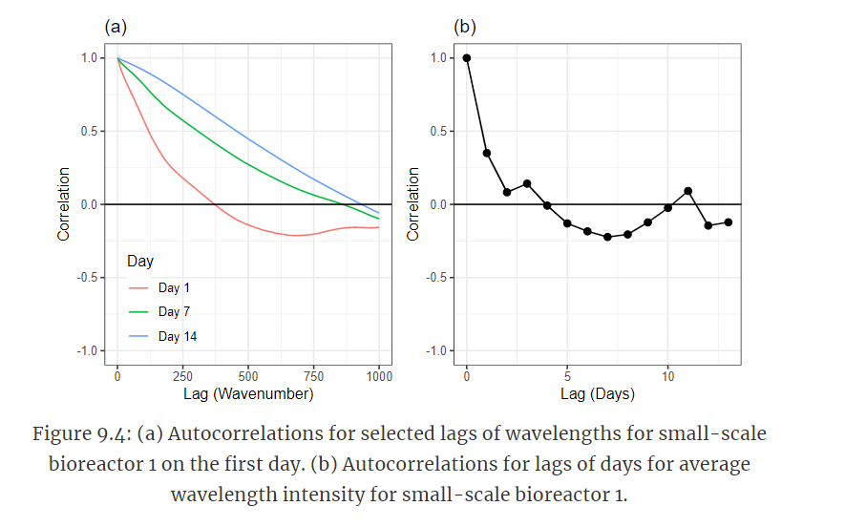
9.2 What are the Experimental Unit and the Unit of Prediction?
hierarchical structure/nested
Autocorrelations can be used to understand the correlation structure at this level of the hierarchy
Figure 9.4 (b) shows the autocorrelations for the first 13 lagged days. Here correlations for the first lag is greater than 0.95, with correlations tailing off fairly quickly.
Data are independent at this level
leave out all of the data for resampling

Slide 4
9.3 Reducing Background
The excess variation that contribute to background can have a detrimental impact on models like principle component regression and partial least squares which are driven by predictor variation.
It is almost impossible to experimentally remove all background. Therefore, the background patterns must be approximated and this approximation must be removed from the observed intensities.

Slide 5
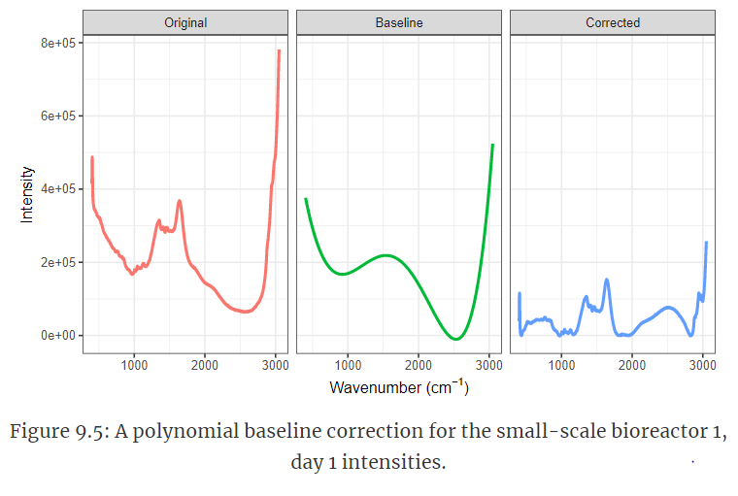
polynomial -approximate the background
A simple and clever way to approximate the background is to use a polynomial fit to the lowest intensity values across the spectrum.

Slide 6
9.4 Reducing Other Noise
Next step -reduce extraneous noise
Trimming
computed by excluding the most extreme values
provides more robust estimates of the center and spread of the data that are typical of the vast majority of the data.
Smoothing splines and moving averages

Slide 7
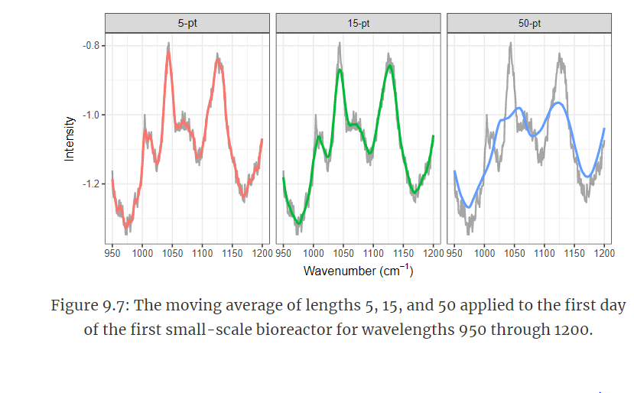
It is important to point out that the appropriate number of points to consider for a moving average calculation will be different for each type of data and application.
Visual inspection of the impact of different number of points in the calculation like that displayed Figure 9.7 is a good way to identify an appropriate number for the problem of interest.

Slide 8
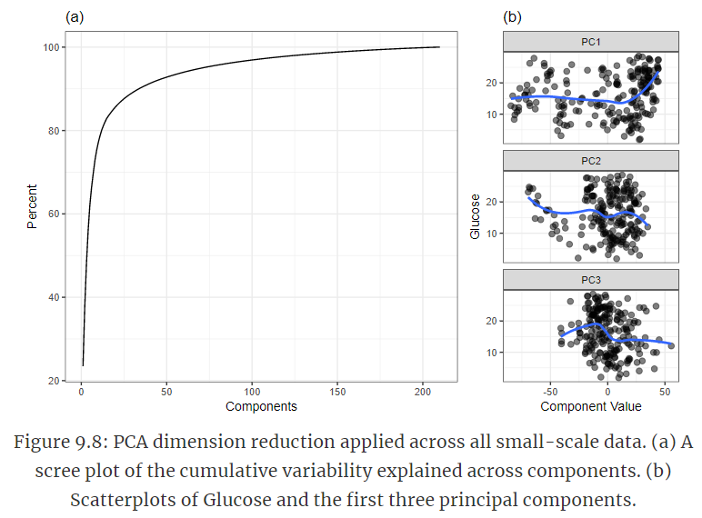
9.5 Exploiting Correlation
Reducing between-wavelength correlation can be accomplished using several previously described approaches in Section 6.3 such as PCA, kernel PCA, or independent component analysis. These techniques perform dimension reduction on the predictors across all of the samples.

Slide 9
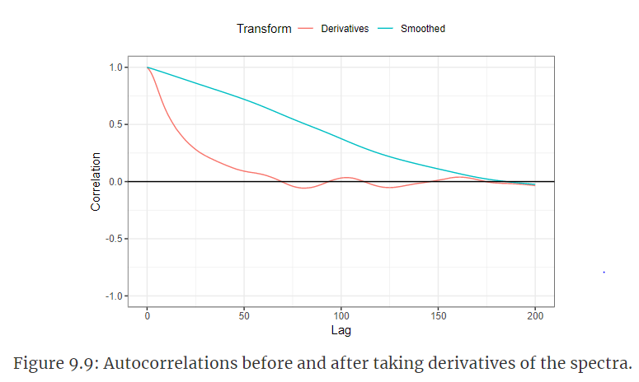
A second approach to reducing correlation is through first-order differentiation within each profile.
Autocorrelation across the profile should greatly be reduced
calculating the first-order difference makes the new values relative to the previous value and removes the relationship with values that are 2 or more steps away from the current value.

Slide 10
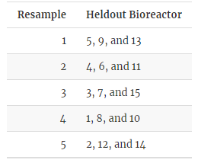
9.6 Impacts of Data Processing on Modeling
The amount of preprocessing could be considered a tuning parameter. If so, then the goal would be to select the best model and the appropriate amount of signal processing
Use small bioreactors are the training data while the large bioreactors are the test data
leave-one-bioreactor-out cross-validation

Slide 11
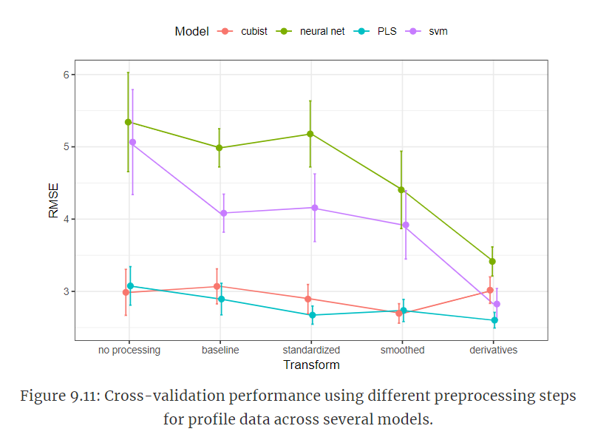
Generally 5 repeats of grouped V-fold cross-validation are sufficient
Partial least squares is a very popular modeling
PLS and PCR are only effective when the relationship between the predictors and the response follows a straight line or plane. These methods are not optimal when the underlying relationship between predictors and response is non-linear.
It shows PLS using derivative features appears to be the best combination

Slide 12
9.7 Summary
Basic preprocessing steps for profiled data can include reducing baseline effect, reducing noise across the profile, and harnessing the information contained in the correlation among predictors
An underlying goal of these steps is to remove the characteristics that prevent this type of data from being used with most predictive models while simultaneously preserving the predictive signal between the profiles and the outcome.

